Slide 1
School Performance Analysis
https://www.kaggle.com/datasets/alizabrand/school-performance-analysis
Why choose dataset? | Relatable. Helps improve education for all
1000 x 8 columns | Gender - 2 Race/Ethnicity - 5 Parents highest level of education - 6 Lunch type(proxy for wealth) - 2 Test preparation - 2 Maths – continuous numerical Reading – continuous numerical English – continuous numerical
Big question | What is the biggest predictor on education performance in terms of Maths, Reading and English
EDA | Eyeball the data Check the distribution of each variable. Charting Missing data review. Duplicates – review and removal. Outliers (check if abnormal scores on all 3 subjects) - Boxplots. Standardise formats Check data types. Convert categorical variables to numerical variables (5) Band scores for Maths, Reading and English – use same banding for each subject (convert to numeric) / create new variables Descriptive statistics Identify correlation analysis (full correlation of all variables) Build a predictive Model – improve model Create dashboard/visualizations/ PowerPoint / Personas

Slide 3
Next steps
How will we move to next steps – divvy up the tasks

Slide 4
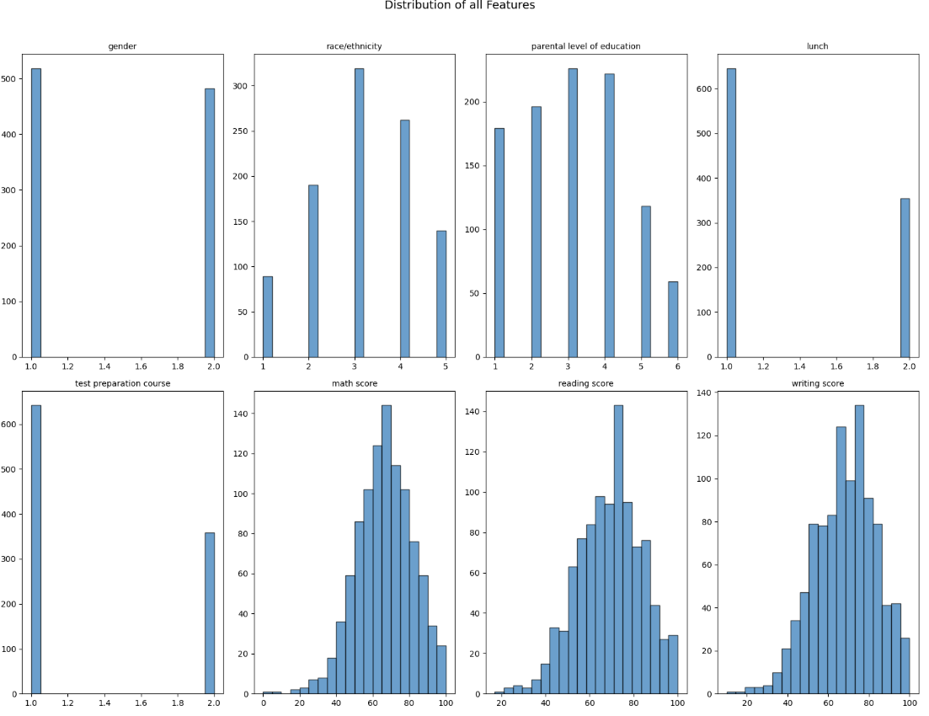

Slide 5
